Slide 1

HOUSING DATASET ANALYSIS
USING PYTHON
NIRANJANA KS
DA&DS
2025 MAY BATCH

Slide 2

INTRODUCTION
•This project aims to analyze housing prices using data science techniques to understand key factors influencing property value. The ultimate goal is to support pricing strategies and investment decisions.
•
Objective: To identify patterns, trends, and statistically significant variables that affect housing prices using EDA and statistical analysis

Slide 3
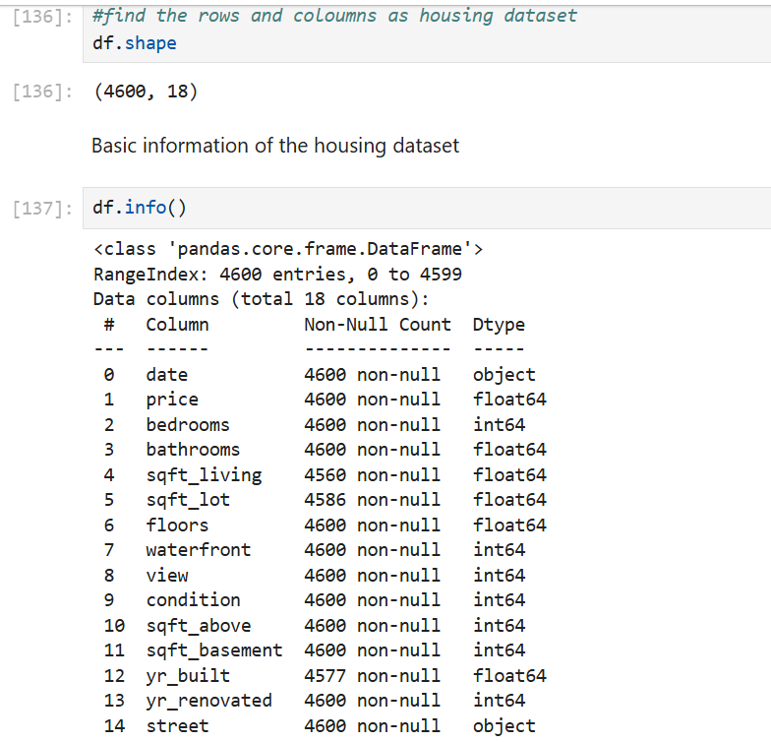
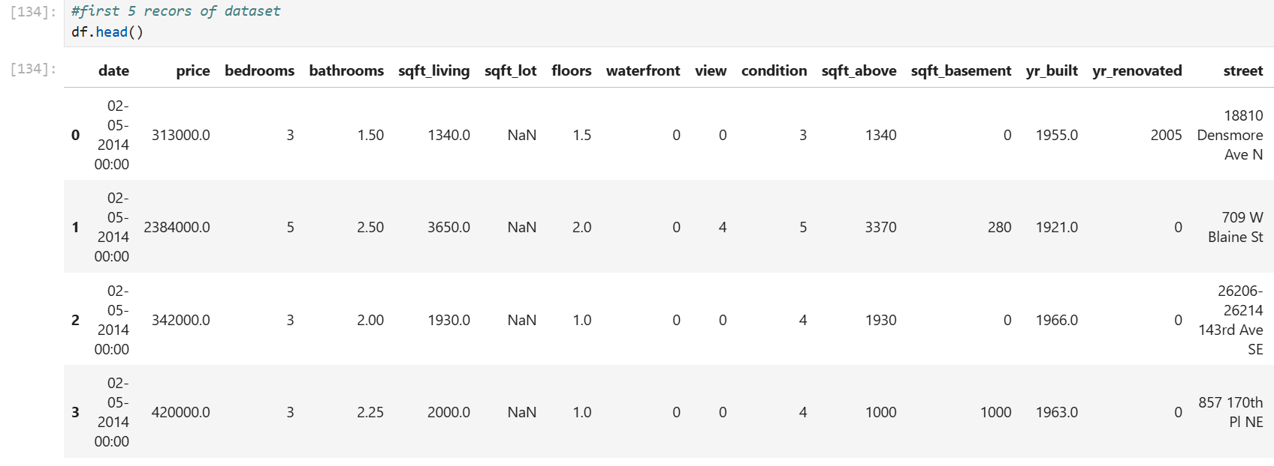
DATA UNDERSTANDING
•Dataset: Housing data from a real-estate listing platform(5000 rows, 18 features)
•Source: housing.csv
•Key Variables: price, sqft_living, bedrooms, bathrooms, condition, city, yr_built, view, waterfront

Slide 4
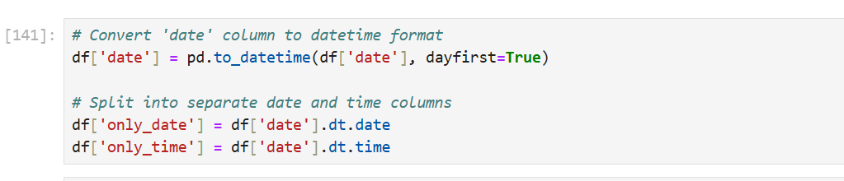
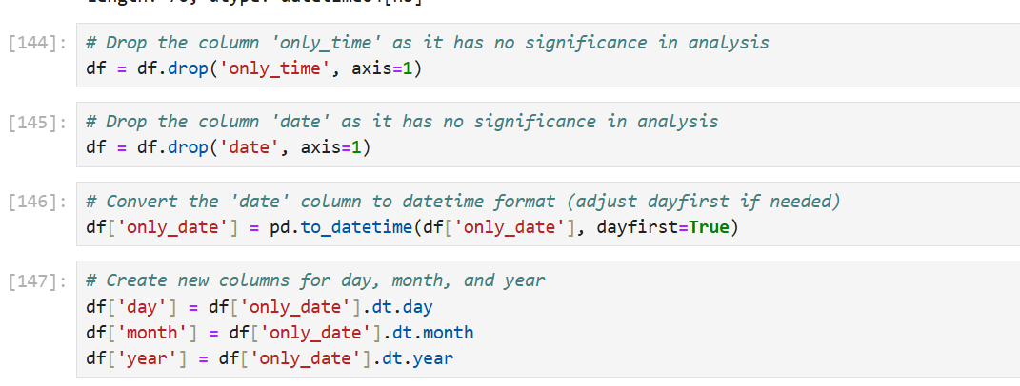
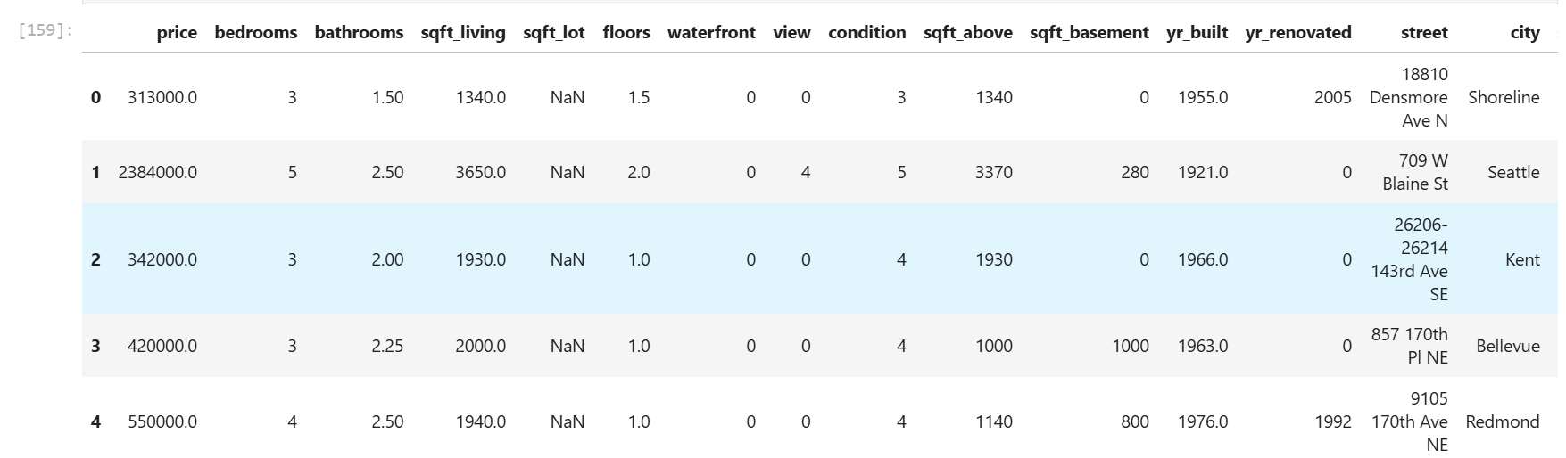
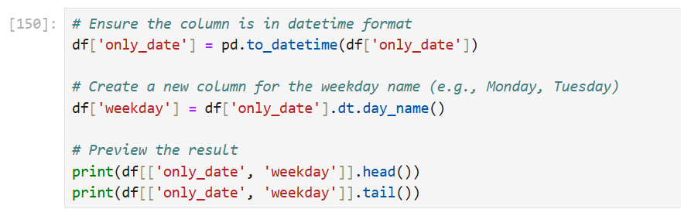
DATA CLEANING
•Removed redundant columns (`date`, `only_time`)
•Extracted date parts into `day`, `month`, `year`
•Converted datatypes for analysis compatibility

Slide 5
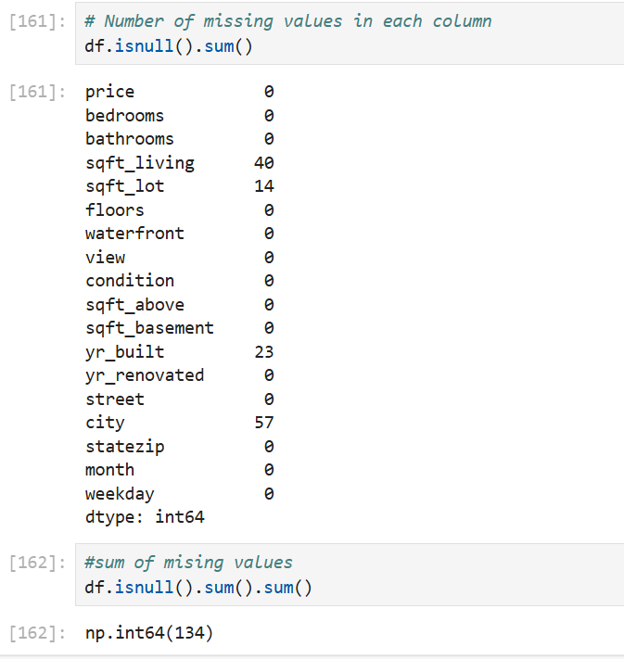
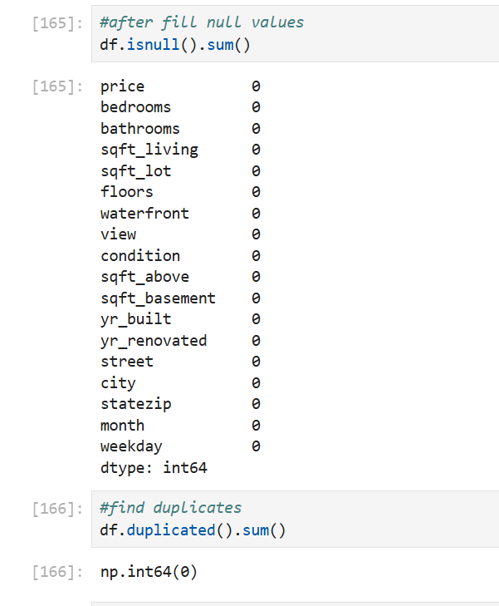
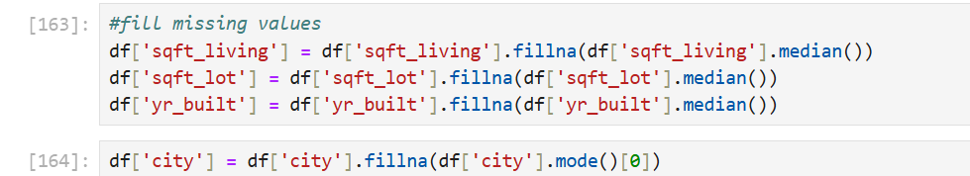
HANDLING MISSING VALUES
•Detected missing values in `sqft_living`, `sqft_lot`, and `city`
•Applied row deletion where appropriate due to small proportion of missing data

Slide 6
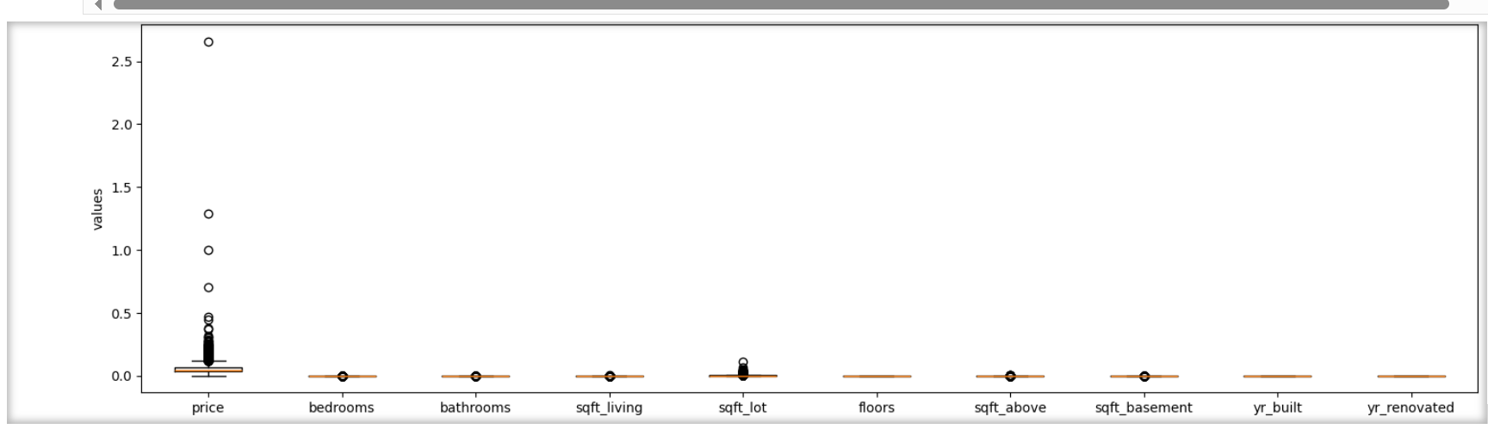
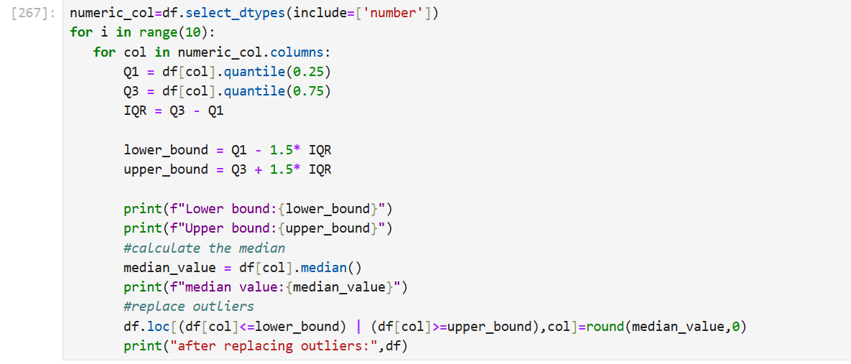
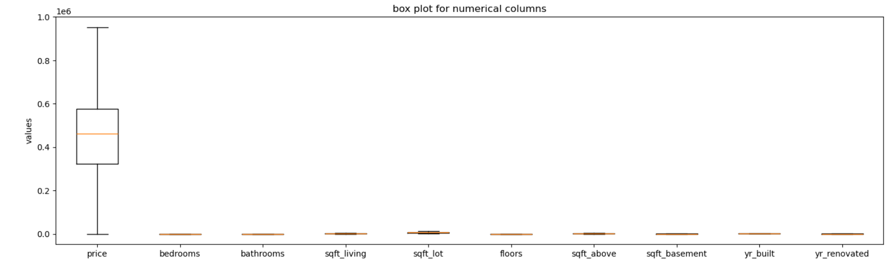
OUTLIER HANDLING
•Identified using IQR method
•Outliers removed or capped for variables like `price`, `sqft_living`, `bathrooms`

Slide 7
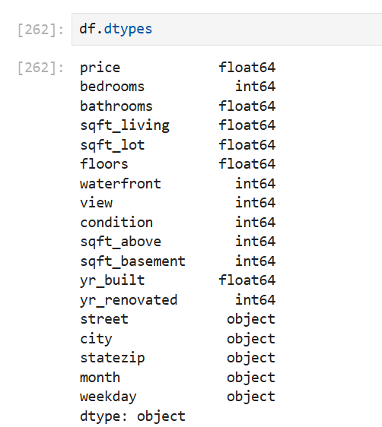
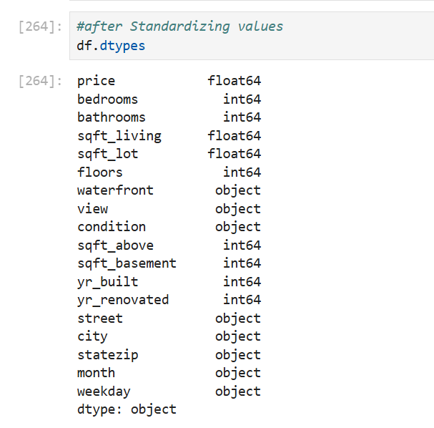
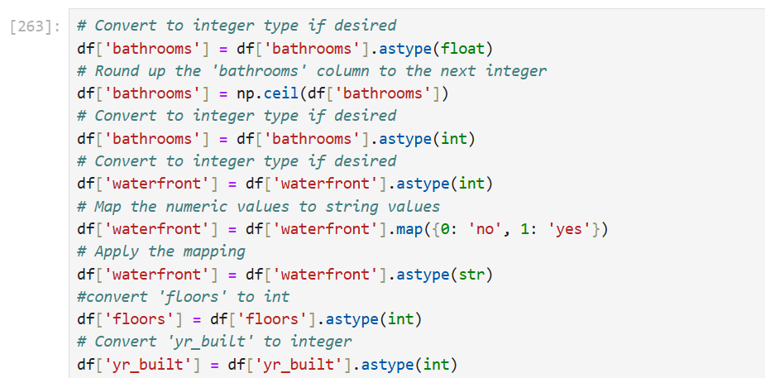
HANDLING INVALID VALUES
•Replaced zero values in fields like `yr_built` and `price` where unrealistic
•Filtered inconsistent entries (e.g., 0 bathrooms)

Slide 8
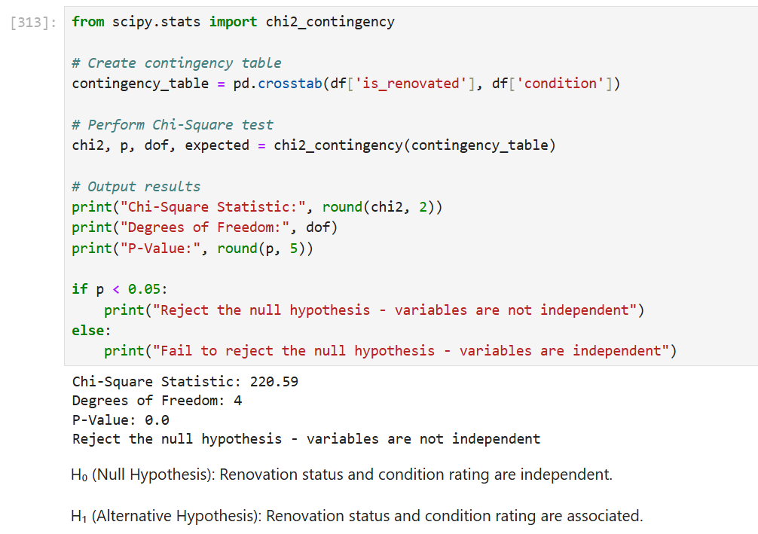
STATISTICAL ANALYSIS
•Tests Used:
One way t-test(price)
• Two-way t-test (renovated vs. non-renovated)
• One way ANOVA (condition vs. price)
• Chi-square (renovation vs. condition)
• Significant p-values confirmed strong statistical relationships

Slide 9
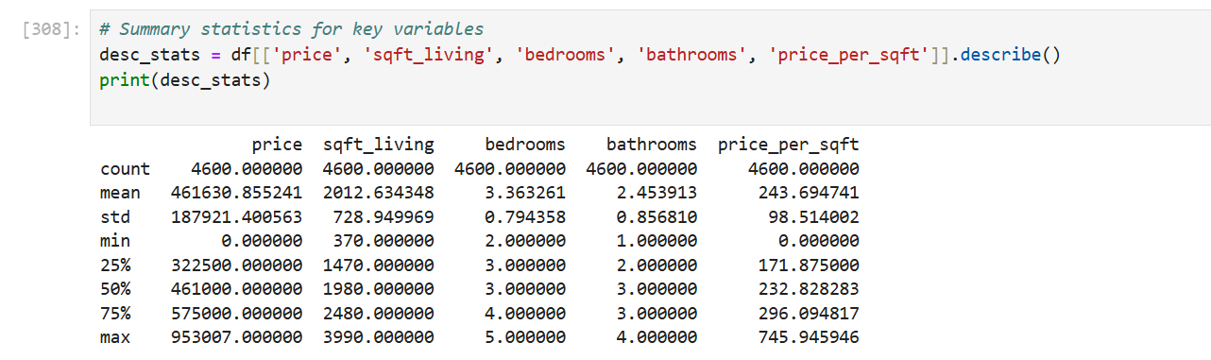
DESCRIPTIVE ANALYSIS
•Mean price: $553,948
•Most common bedroom count: 3
•Most homes: 2–2.5 bathrooms, 1500–2500 sqft
•Condition: majority average (rating 3)

Slide 10
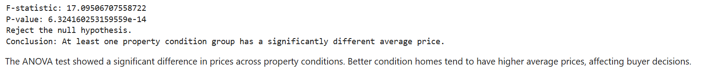
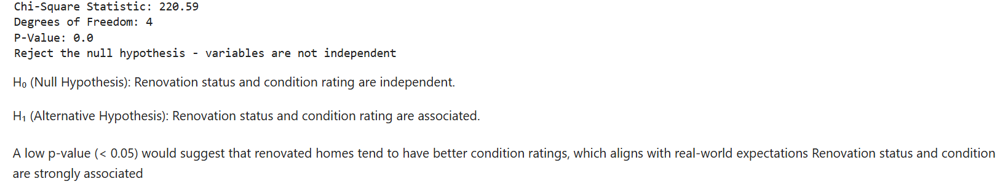
RELATIONSHIP BETWEEN VARIABLES
•Larger sqft_living strongly correlates with price
•Renovation, view, and condition also significantly impact price
•Chi-square showed renovation affects condition

Slide 11
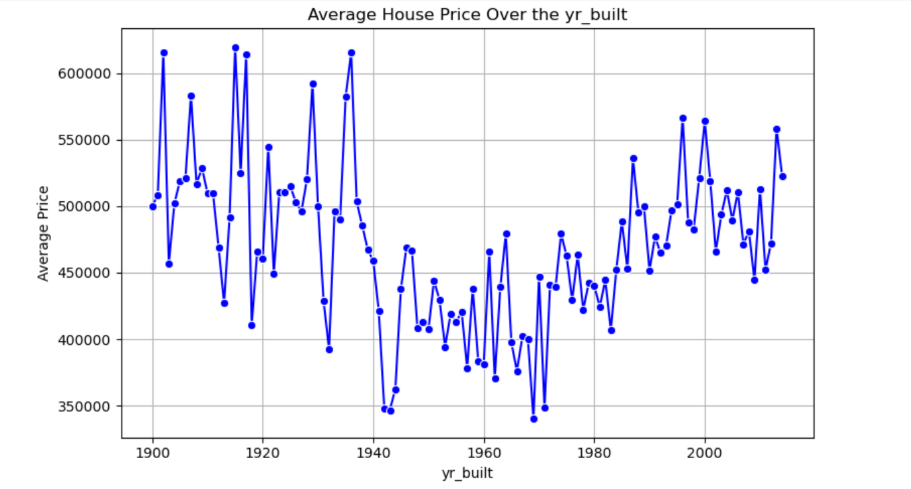
DATA VISUALIZATION
•Countplots, histograms, sctter plots, box plots, heatmaps
•Used Seaborn and Matplotlib for plottin

Slide 12
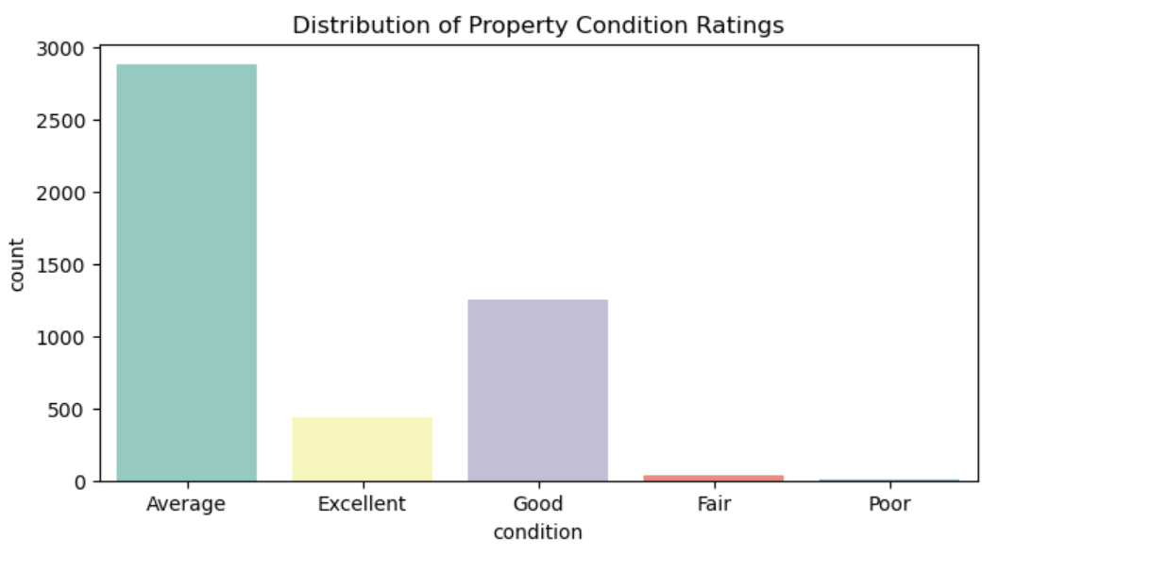
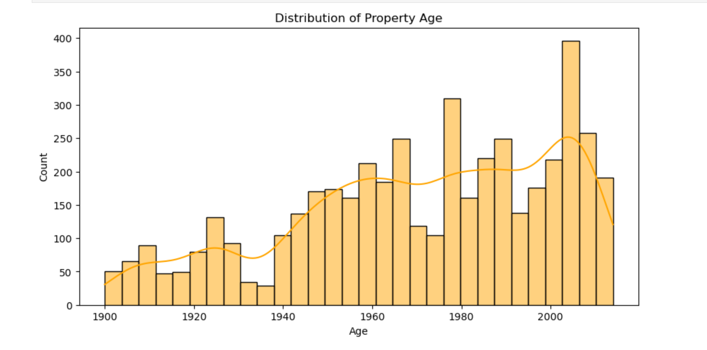
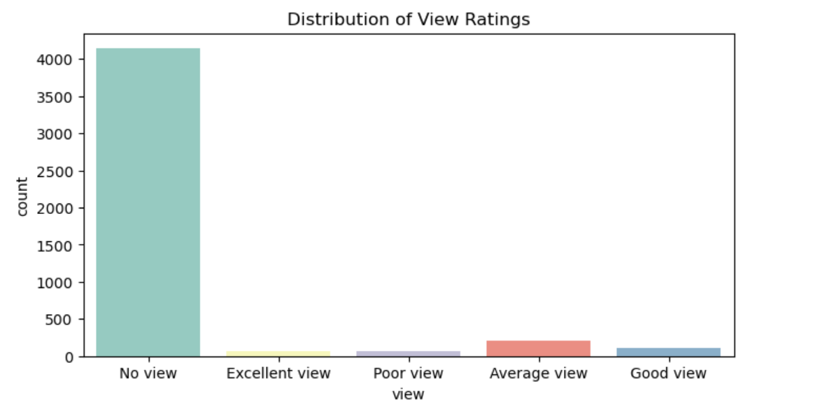
UNIVARIATE ANALYSIS
•Price: Right-skewed (luxury homes drive high values)
•Bedrooms: Most homes have 3
•Bathrooms: Most homes have 2 to 3
•Condition: Most rated as average

Slide 13
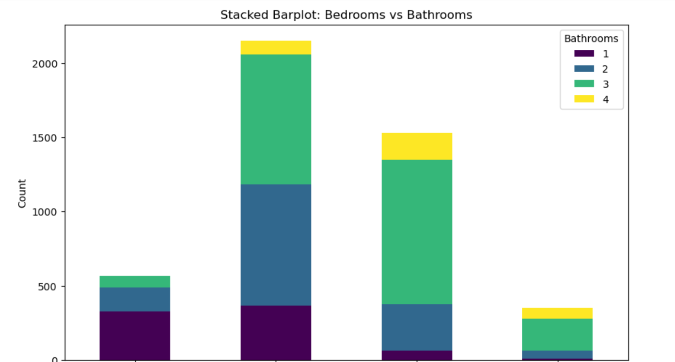
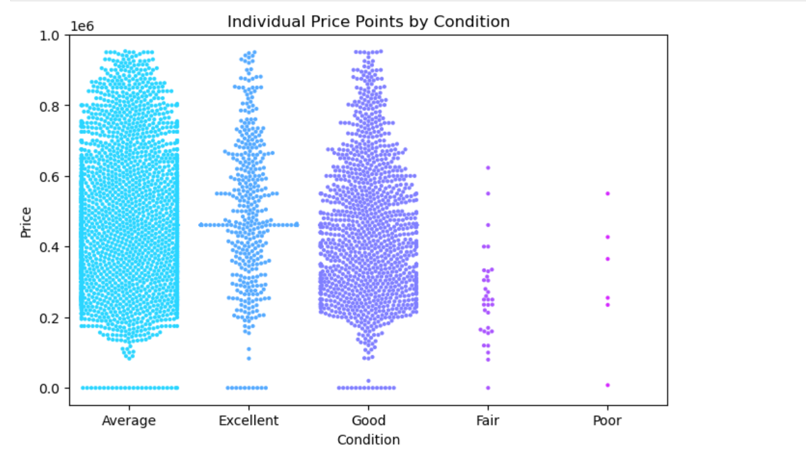
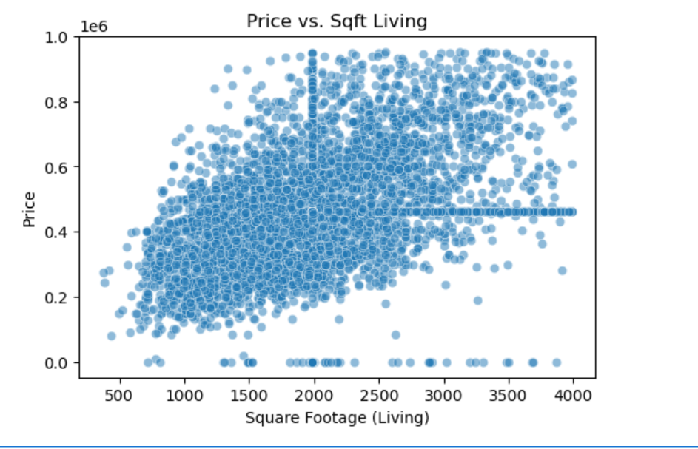
BIVARIATE ANALYSIS
•Scatter plot: `sqft_living` vs. `price`
•Boxplot: `condition` vs. `price`
•Stacked bar: bedrooms vs. bathrooms
•Line plot: `yr_built` vs. `price`

Slide 14
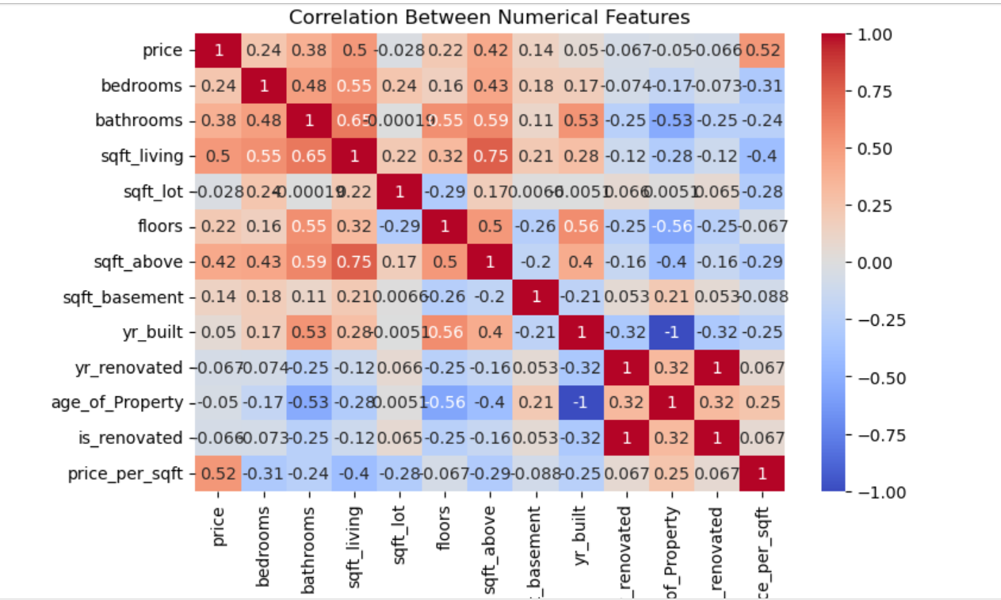
MULTIVARIATE ANALYSIS
•Pairplot: `price`, `sqft_living`, `bathrooms`, `bedrooms`
•Heatmap: Correlation among numerical features
•City-level countplot for top 10 cities

Slide 15
CONCLUTION ANDRECOMENTATION
•Final Insights:
•- Most homes are priced in the low-to-mid range
•- Luxury homes skew the price distribution
•- 3-bed, 2-bath homes dominate the market
•- Larger homes, better views, newer builds, and renovation lead to higher prices
•- City and zip code significantly affect price
•
•Recommendations:
•- Target renovations for aging homes
•- Focus on larger or better-located properties
•- Use median pricing for fair value assessment

Slide 16
Thank You For Your Attention

